Slide 1

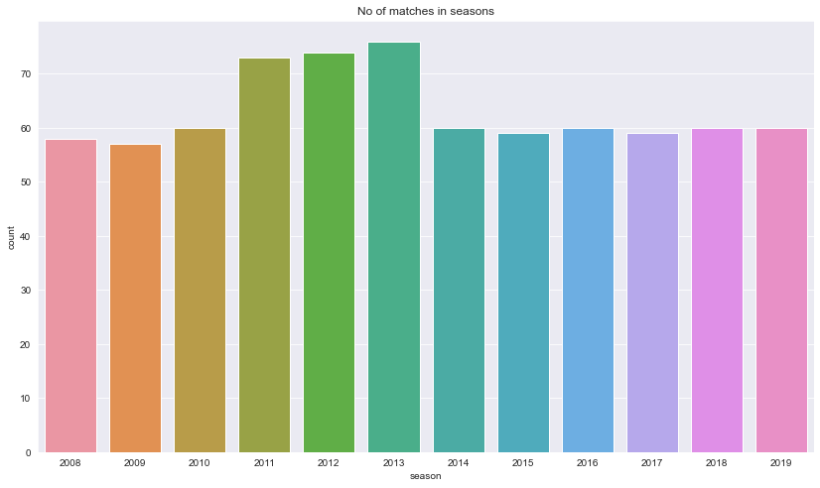
IPL DATA ANALYSIS
Statistics of matches played in all season
number of matches played in each season by grouping the match_id, season column and counting out the data, and then calling the index out of it by dropping the first index layer that is the match_id.
Most highest matches played in 2013 which is 76.
IPL Data Analysis| 28/05/2022
CASES :
IPL seasons match count.
Familiarizing with data.
Visulizing the data
Analysis data.
Name: Harsh Dilip Jadhav
Email: jadhavharsh21997@gmail.com

Slide 2
2. Familiarizing with data.
Description of deliveries dataset:
 | match_id | inning | over | ball | is_super_over | wide_runs | bye_runs | legbye_runs | noball_runs | penalty_runs | batsman_runs | extra_runs | total_runs
count | 179078 | 179078 | 179078 | 179078 | 179078 | 179078 | 179078 | 179078 | 179078 | 179078 | 179078 | 179078 | 179078
mean | 1802.252957 | 1.482952 | 10.162488 | 3.615587 | 0.000452 | 0.036721 | 0.004936 | 0.021136 | 0.004183 | 0.000056 | 1.246864 | 0.067032 | 1.313897
std | 3472.322805 | 0.502074 | 5.677684 | 1.806966 | 0.021263 | 0.251161 | 0.11648 | 0.194908 | 0.070492 | 0.016709 | 1.60827 | 0.342553 | 1.605422
min | 1 | 1 | 1 | 1 | 0 | 0 | 0 | 0 | 0 | 0 | 0 | 0 | 0
25% | 190 | 1 | 5 | 2 | 0 | 0 | 0 | 0 | 0 | 0 | 0 | 0 | 0
50% | 379 | 1 | 10 | 4 | 0 | 0 | 0 | 0 | 0 | 0 | 1 | 0 | 1
75% | 567 | 2 | 15 | 5 | 0 | 0 | 0 | 0 | 0 | 0 | 1 | 0 | 1
max | 11415 | 5 | 20 | 9 | 1 | 5 | 4 | 5 | 5 | 5 | 7 | 7 | 10
Description of matches dataset:
 | id | season | dl_applied | win_by_runs | win_by_wickets
count | 756 | 756 | 756 | 756 | 756
mean | 1792.178571 | 2013.444 | 0.025132 | 13.283069 | 3.350529
std | 3464.478148 | 3.366895 | 0.15663 | 23.471144 | 3.387963
min | 1 | 2008 | 0 | 0 | 0
25% | 189.75 | 2011 | 0 | 0 | 0
50% | 378.5 | 2013 | 0 | 0 | 4
75% | 567.25 | 2016 | 0 | 19 | 6
max | 11415 | 2019 | 1 | 146 | 10

Slide 3
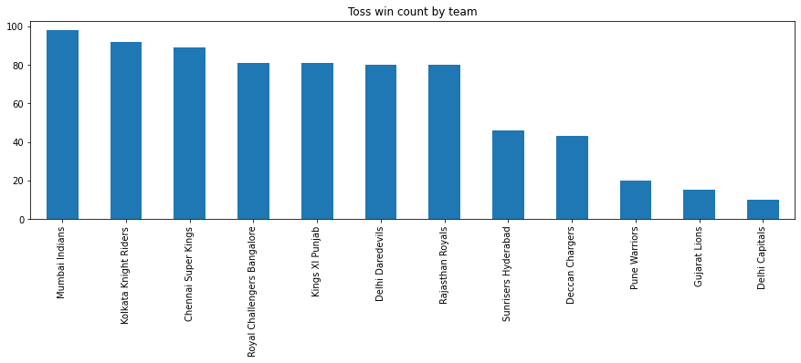
3. Data analysis:
Toss win count of each team.
In this data I calculate the toss win of each team.
in this bar graph as we can see that Mumbai Indians has won the most tosses in overall IPL season which is 98.
Followed by KKR and CSK
teams | toss score
Mumbai Indians | 98
Kolkata Knight Riders | 92
Chennai Super Kings | 89
Royal Challengers Bangalore | 81
Kings XI Punjab | 81
Delhi Daredevils | 80
Rajasthan Royals | 80
Sunrisers Hyderabad | 46
Deccan Chargers | 43
Pune Warriors | 20
Gujarat Lions | 15
Delhi Capitals | 10
Kochi Tuskers Kerala | 8
Rising Pune Supergiants | 7
Rising Pune Supergiant | 6

Slide 4
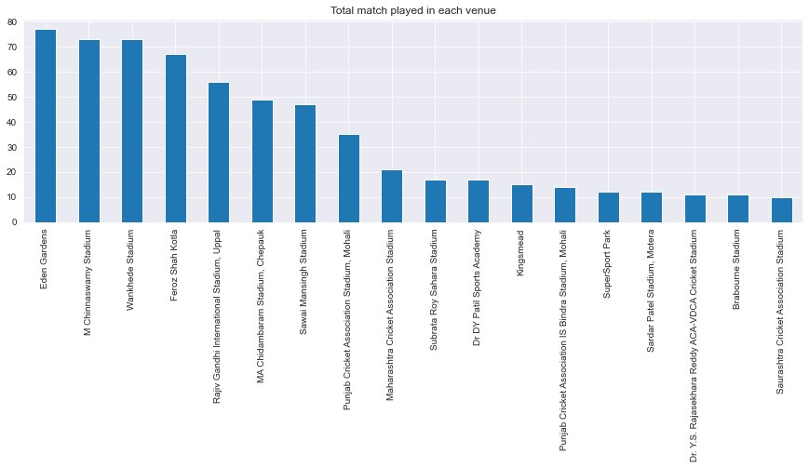
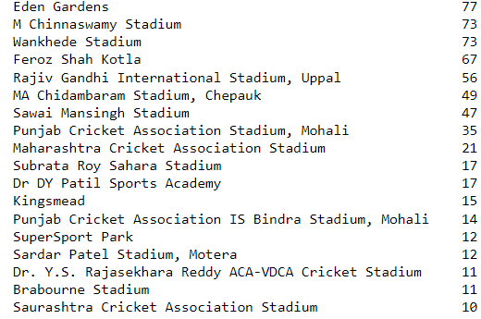
Data analysis:
Count of match played in each venue.
In this data we calculate most number of matches played in each ground.
In this bar graph as we can see that on Eden Garden stadium maximum number of matches of IPL seasons.

Slide 5
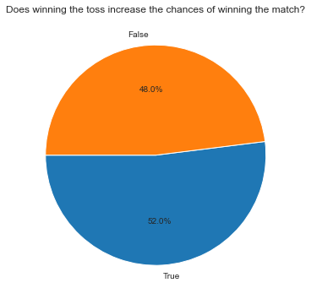
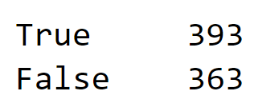
Toss win or match win prediction
In this data we calculate the prediction of “Does winning the toss increase the chances of win the match or not”.
As we can refer the pie chart we can analysis that 52% of chances of win the match who win the toss.

Slide 6
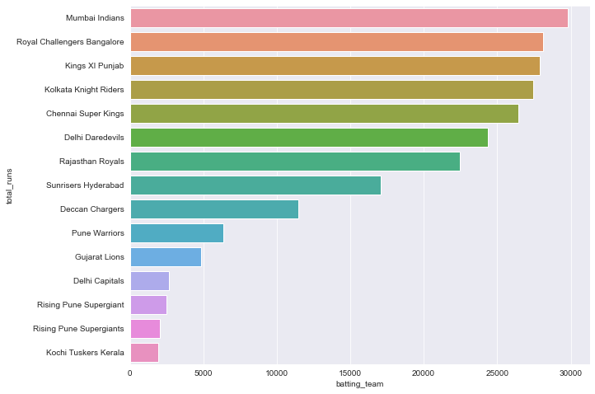
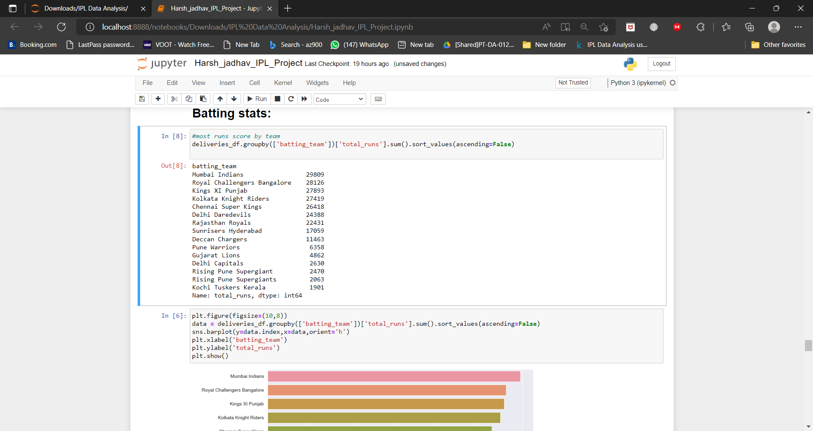
Most runs score by teams.
In this data we calculate the most runs scored by the teams in whole IPL Season.
As we can refer the bar chart we can see the Mumbai Indians score the most runs in the IPL season which is 29809.

Slide 7
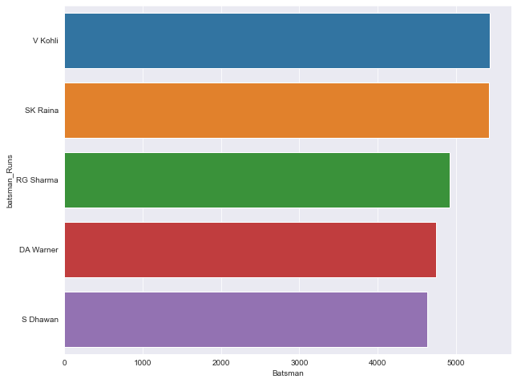
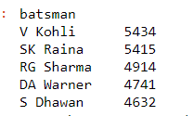
Most runs by batsman .
In this data we calculate the most runs scored by individual player in whole IPL Season.
As we can refer the bar chart we can see the Virat Kohli score the most runs in the IPL season which is 5434.

Slide 8
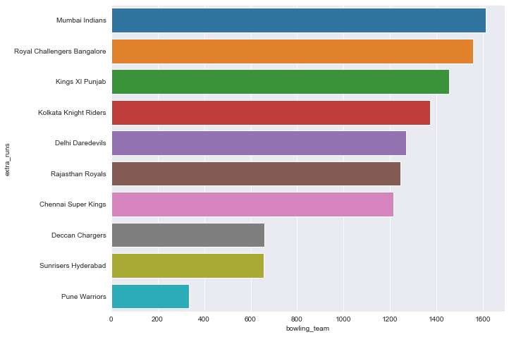
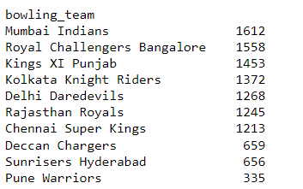
Most runs given by team.
In this data we calculate the most runs given by which team in whole IPL Season.
As we can refer the bar chart we can see the Mumbai Indians has spend most runs in the IPL season which is 1612.

Slide 9
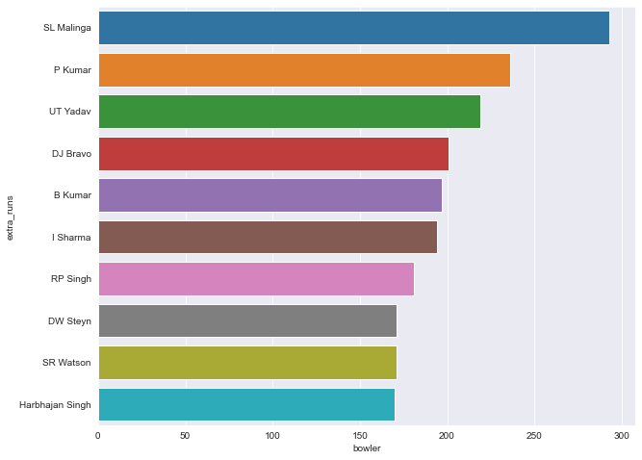
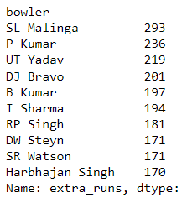
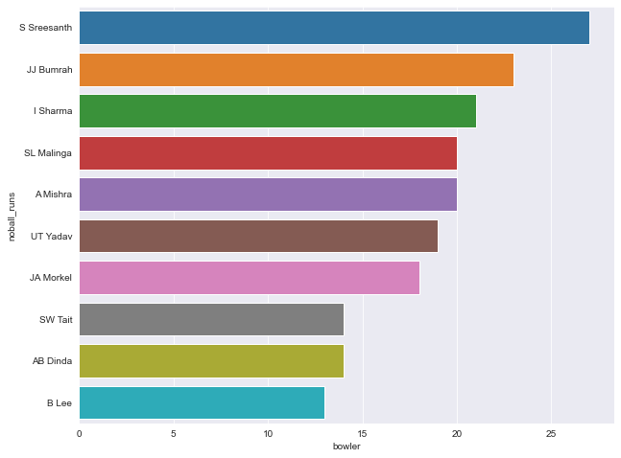
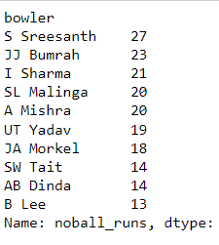
Extra runs stats.
In this data we calculate the extra runs given by individual bowler in whole IPL Season.
As we can refer the bar chart we can see the Lasith Malinga has spend most runs in the IPL season which is 293.
In this data we calculate the most no balls by individual bowler in whole IPL Season.
As we can refer the bar chart we can see the S Sreesanth has bowl most no balls in the IPL season which is 27.

Slide 10
4.conclusion.
IPL is most popular event in India since 2008. players from all over world like to play in IPL with their great performance. In this data sheet we can conclude that highest reaches in batting & bowling , most runs by team, most matched played at which venue from 12 seasons of IPL. Also we analysed that prediction depends upon tossed either by win or loss.

